Slide 1

Overcoming AIR-BNB NYC Business in the Post - COVID period
FOR HEAD OF ACQUISITION & OPERATIONS AND HEAD OF USER EXPERIENCE
BY :
NIKHIL KUMAR SINGH

Slide 2
Agenda
Objective
Background
Key findings
Recommendations
Appendix:
Data sources
Data methodology
Data model assumptions

Slide 3
OBJECTIVE
IMPROVE OUR SHARED UNDERSTANDING ABOUT THE MARKET CONDITION OF AIRBNB COMMUNITY.
IMPROVE OUR SHARED UNDERSTANDING ABOUT OUR END CONSUMER EXPERIENCE AND PREFERENCES.
PROVIDE EARLY RECOMMENDATIONS TO HEAD OF ACQUISITION & OPERATIONS AND HEAD OF USER EXPERIENCE.

Slide 4
Background
FOR THE PAST FEW MONTHS, AIRBNB HAS SEEN A MAJOR DECLINE IN REVENUE.
THE COVID – 19 PANDEMIC AFFECTED AIR-BNB BUSINESS DUE TO TRAVLE RESTRICTIONS.
RESTRICTIONS HAVE STARTED LIFTING AND PEOPLE HAVE STARTED TO TRAVEL MORE AND THUS A THOROUGH ANALYSIS WAS NEEDED TO RECOVER THE LOSSES INCURRED.

Slide 5
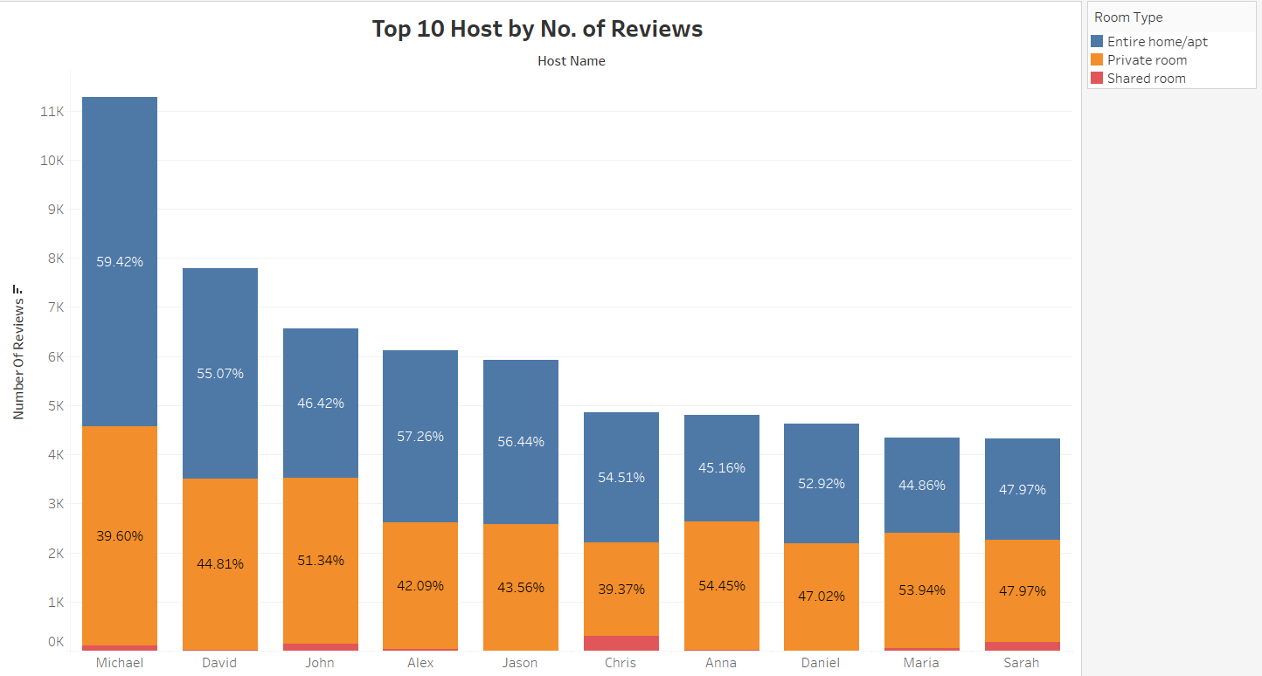
Top 10 hosts by No. of Reviews
People prefer renting out entire home/apt for stay and if that is not an option than they prefer to rent private rooms.
Shared rooms accounts the least number of reviews of total listed properties.
More than 90% of people wants to rents either entire home/apt or private rooms for there stay.

Slide 6
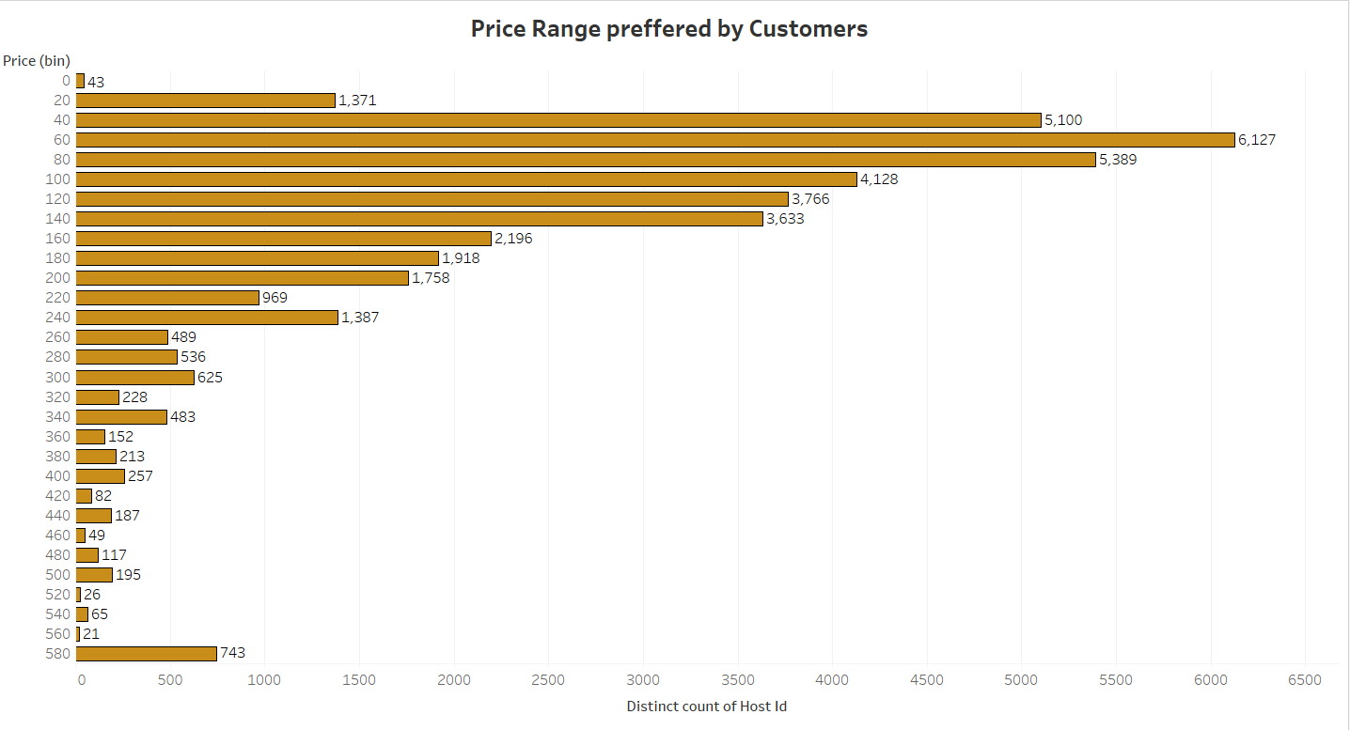
Price Range preferred by Customers
We have taken pricing preference based on volume of bookings done in a price range.
The favourable price range is from $20 - $240. This is the price range preferred by most customers.
The least favourable price range is from $320 - $560. This price range is preferred by less customers.

Slide 7
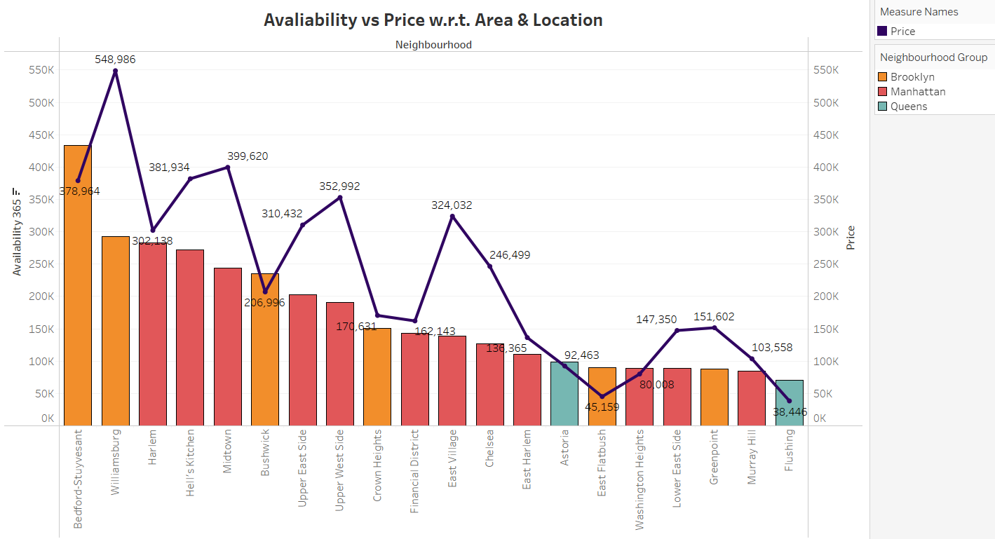
Availability vs Price
Availability of Bedford-Stuyvesant is highest and its price is on the lower side. It is a good choice for customers.
Williamsburg availability is low as compared to its price. It’s availability is 292,913 and it’s price is 548,986 which is double of it’s availability.
Brooklyn & Manhattan have the highest availability.

Slide 8
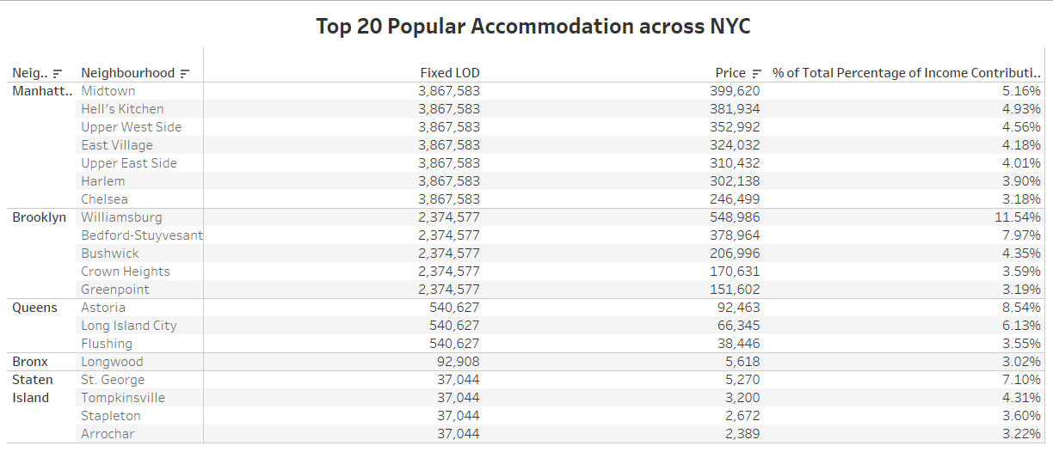
Popular Accommodation across NYC
These are the top 20 most popular accommodation across New York City and how much they contribute to the total Income contribution.
Williamsburg in Brooklyn has the highest contribution in total income which is expected as it’s price is highest among all the other accommodations.
Bronx has only one area Longwood which is in top 20 popular accommodation.

Slide 9
Recommendations
More than 90% people prefer renting out either entire home/apt or private rooms so we should acquire more of these room types to generate more revenue.
We should concentrate on increasing our listings in Staten Island and Bronx because we have very less listings on this locations.
The favourable price range is from $20 - $240 so we should keep the accommodations price in this range or list some more accommodations within this price range to acquire more customers and generate more revenue.

Slide 10
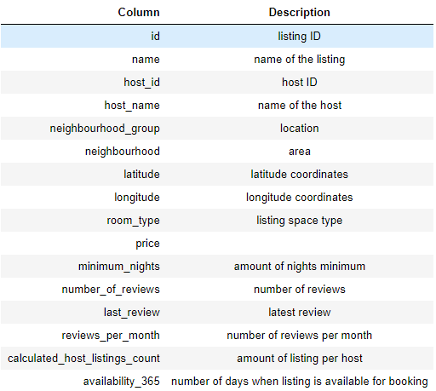
Appendix – Data Sources
DATA SOURCE : NYC AIR-BNB data-set provided.
The data-set columns are self-explanatory.
Here is a snapshot of our data dictionary.

Slide 11
Appendix – Data Methodology
Data understanding, preparation and pre-processing :
Reading and Understanding data.
Treating missing values.
Treating outliers.
We used python jupyter notebook to perform this steps.
Used Tableau for data visualization for deeper analysis.
The methodology document file has been attached with it which has the overall process and snapshot of our whole analysis.

Slide 12
Appendix – Data model Assumptions
We assumed the data prior to the COVID - 19 period was achieving the desired revenue.
The company’s strategies are decided considering the travel will increased in the post COVID period.
The company is not now seeking to expand to additional cities around New York City.
THANK YOU

